Slide 1

SECOND-HAND CAR VALUE PREDICTION

Slide 2

BUSINESS UNDERSTANDING
WEB SCRAPPING
DATA UNDERSTANDING
DATA CLEANING
EXPLORATORY DATA ANALYSIS
DATA PREPROCESSING
MODELING
EVALUATION
DEPLOYEMENT
This Photo by Unknown Author is licensed under CC BY-SA

Slide 3

FINAL GOAL
The final goal of this project is to predict the best price to second-hand cars for the selected features.

Slide 4
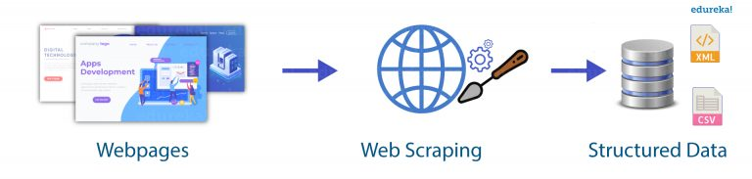
WEB SCRAPPING
Web scraping is the process of collecting and parsing raw data from the Web.
The python packages and other tools, we use here for scrapping the data are selenium, Beautifulsoup, HTML, CSS and requests.
Website :- QUIKR (https://www.quikr.in/)

Slide 5
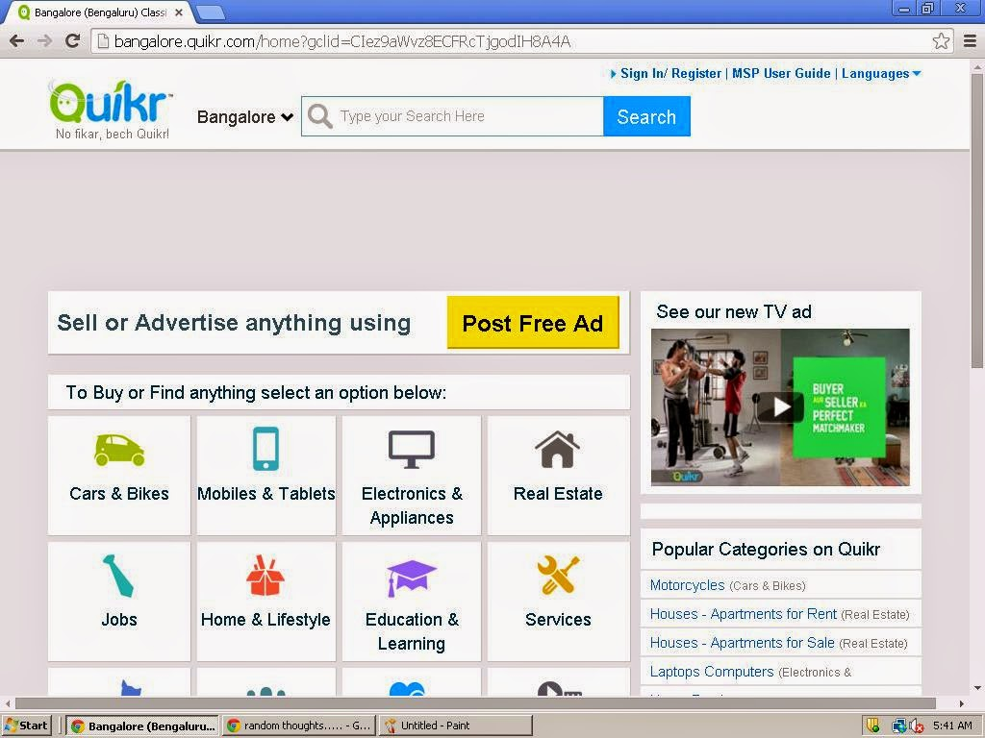
WEB scrapping data WITH HTml

Slide 6
DATA UNDERSTANDING
1.LINK - URL OF THE PRODUCT DESCRIBED.
2.PRICE - PRICE OF THE PRODUCT DISPLAYED.
3.AD-ID - ID NUMBER PROVIDED BY QUIKR TO PERTICULAR ADVERTISEMENT.
4.BRAND - BRAND NAME OF THE CAR MANUFACTURERS.
5.YEAR - MANUFACTURING YEAR OF THE CAR.
6.KMS DRIVEN - NO. OF KILOMETRES CAR HAVE BEEN DRIVEN BY ITS PREVIOUS OWNER.
7.FUEL TYPE - DENOTES THE FUEL TYPE TO WHICH CAR BELONGS.
8.MODEL - DENOTES THE MODEL OF THE CAR IN THAT PERTICULAR BRAND DEFINED.
9.VARIANT - DENOTES THE ENGINE VARIANT OF THE CAR DISPLAYED.
10.COLOR - COLOR OF THE CAR.
11.LOCATION - LOCATION OF THE CAR REGISTERED.

Slide 7
DATA CLEANING
Data cleaning is the process of removing, correcting, and structuring data within a data set so that it’s generally uniform and prepared for analysis. This includes removing corrupt or irrelevant data and formatting it into a language that computers can understand for optimal analysis.
Main aim of data cleaning is to identify and remove incorrect and duplicate data in order to create reliable data.

Slide 8
DATA CLEANING
Remove unwanted data
Handling null values
Removing ₹ symbol from Price column
Removing , symbol from Price and Distance column
Removing KM text from Distance column
Converting all the columns into lower case
If continuous data is in object, we converted into float with the help of .astype(float)

Slide 9
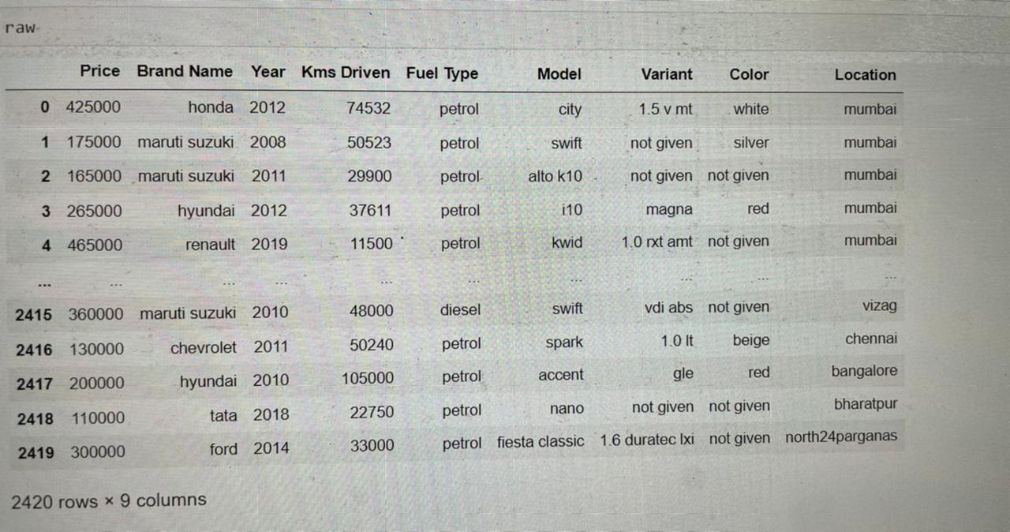
CLEAn data

Slide 10
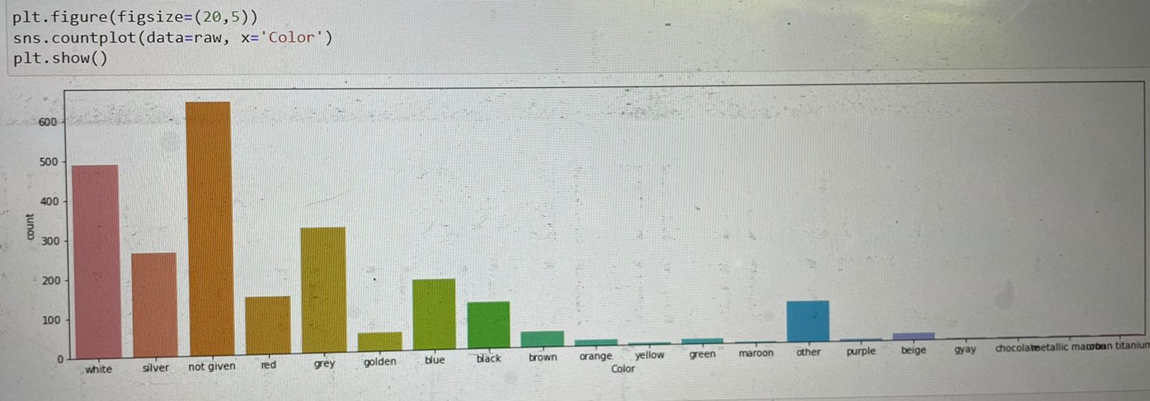
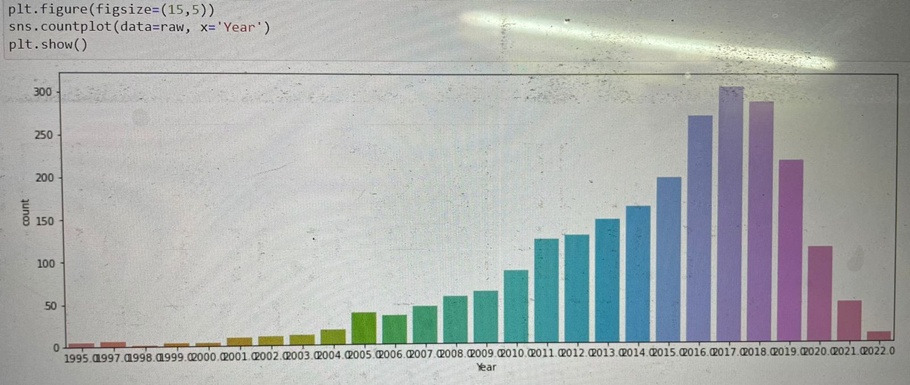
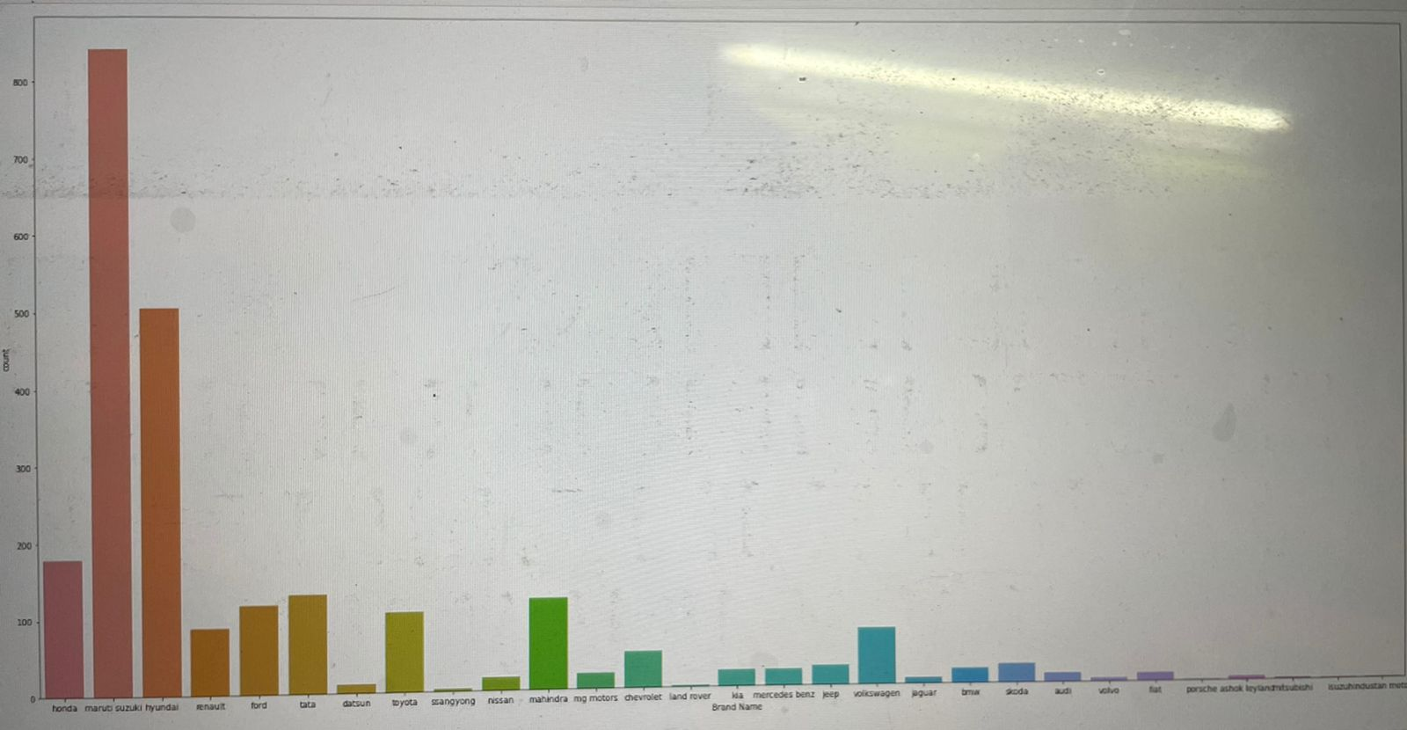
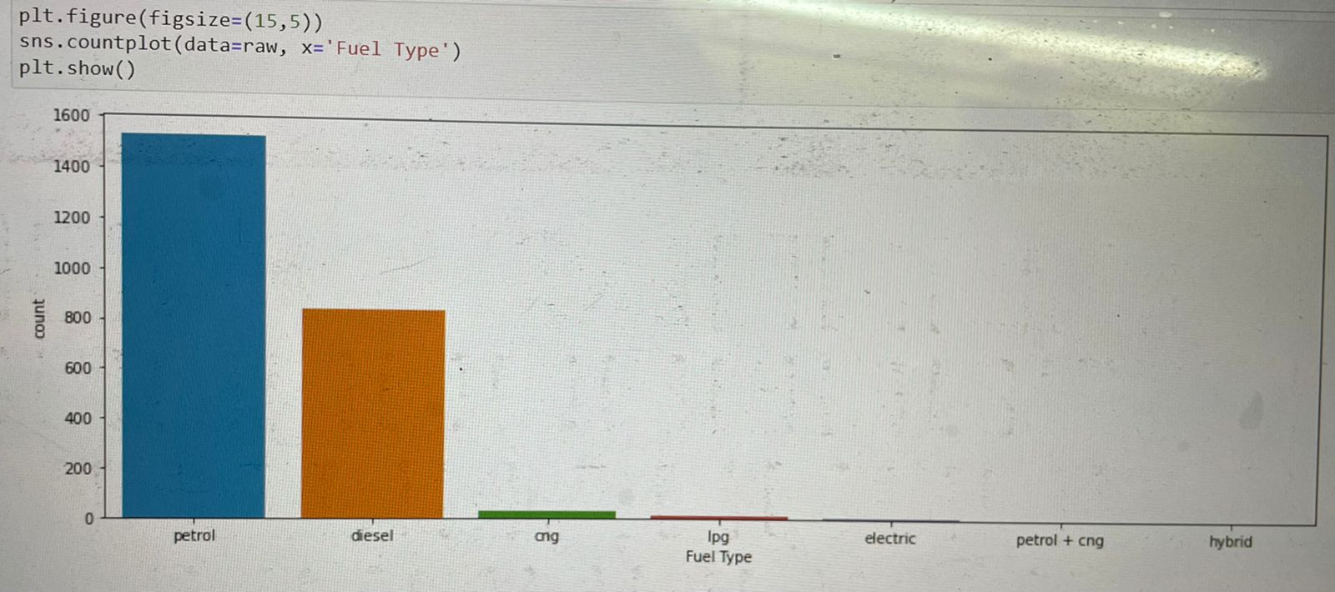
EXPLORATORY DATA ANALYSIS
UNIVARIANT ANALYSIS

Slide 11
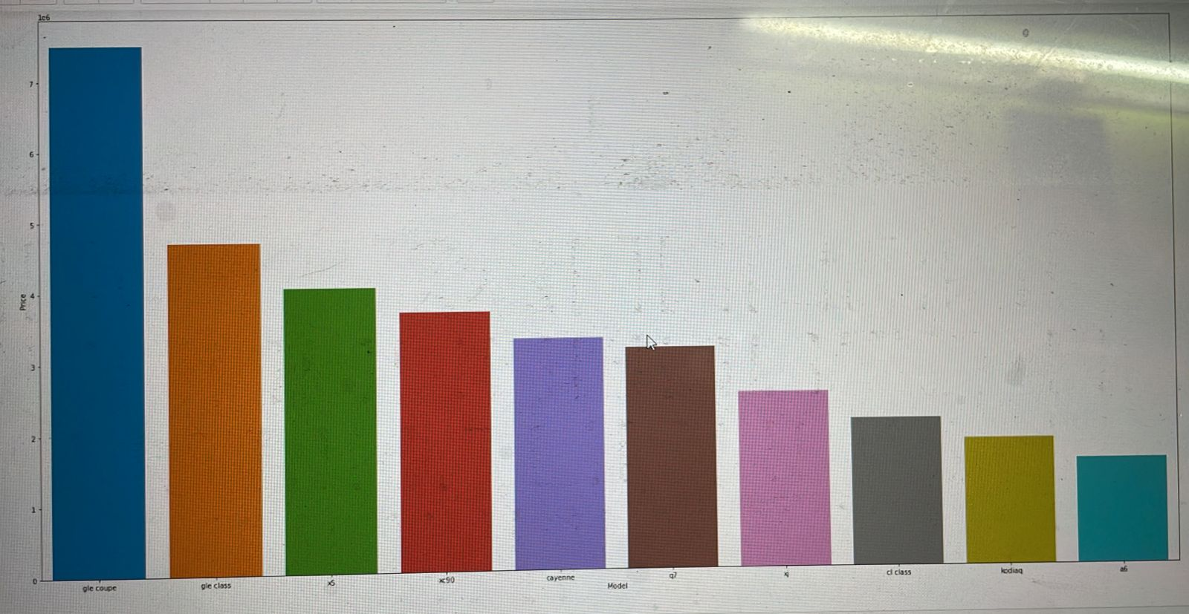
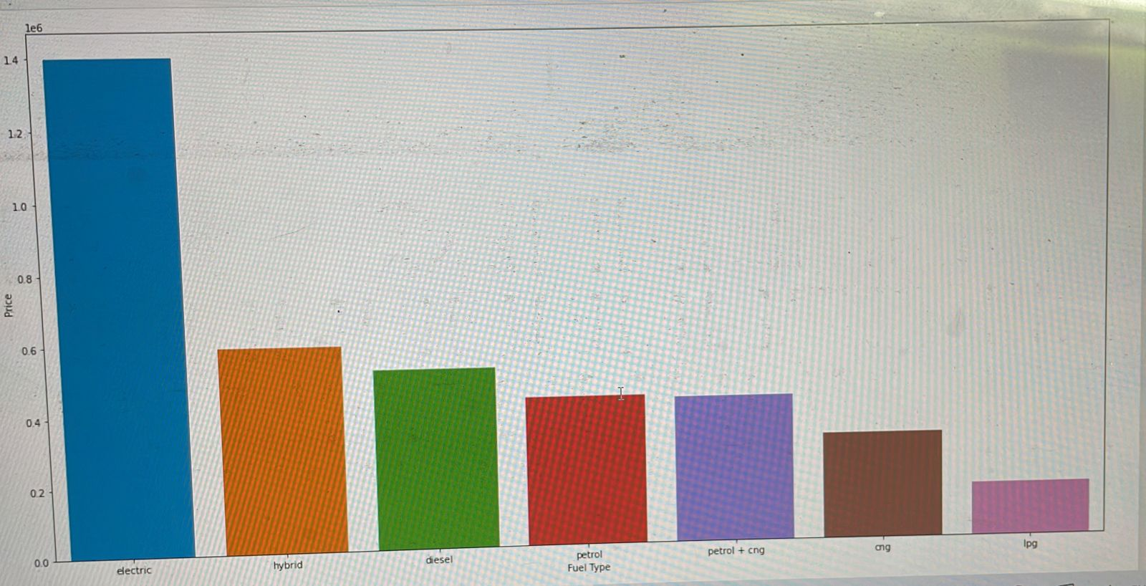
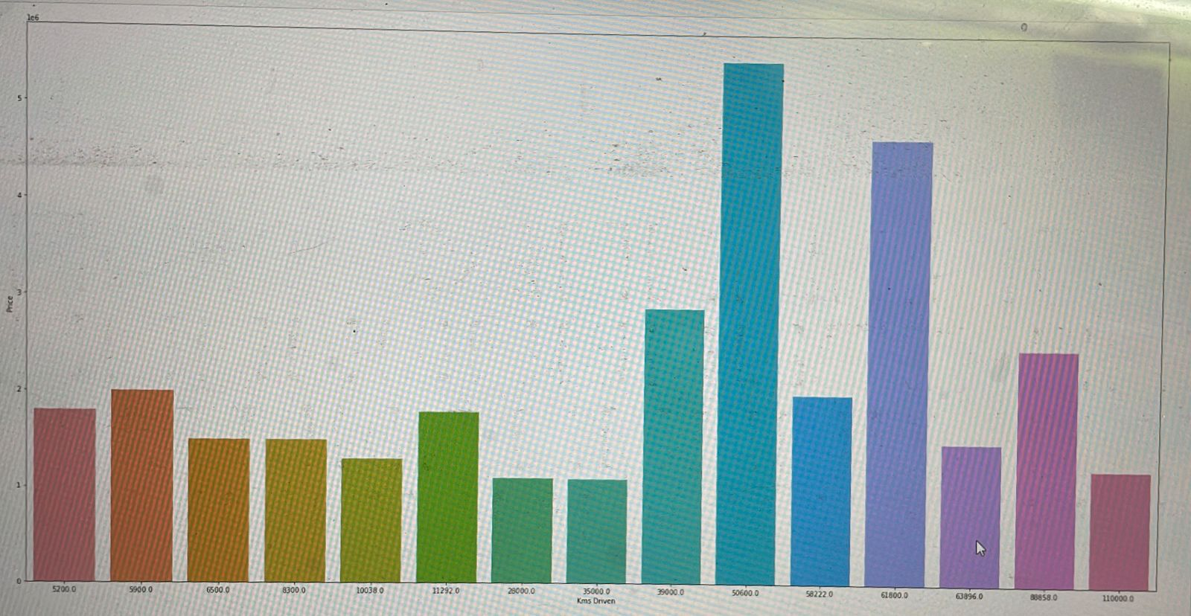
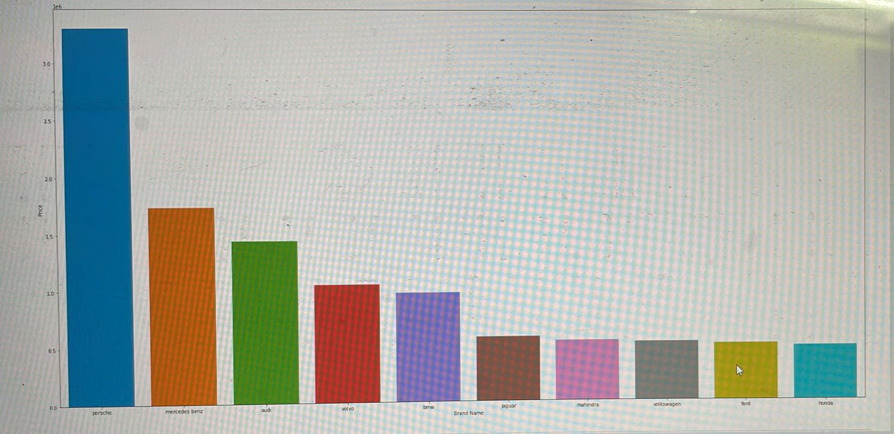
BIVARIANt ANALYSIS

Slide 12
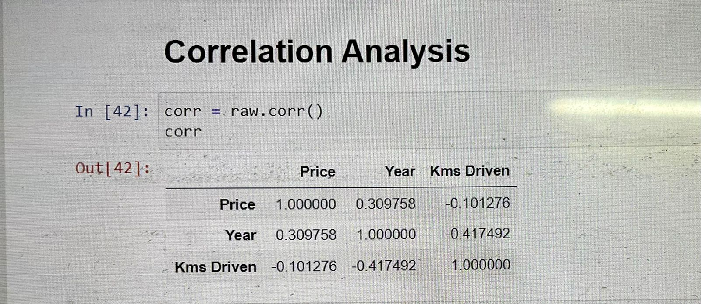
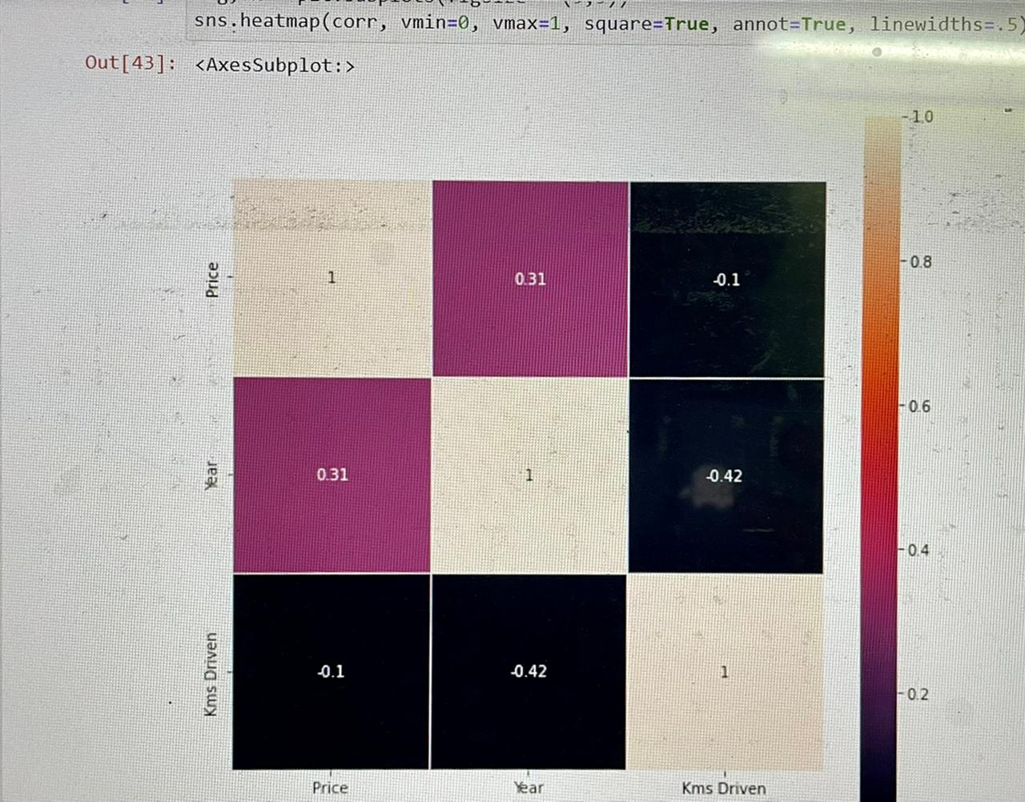
CORRELATION ANALYSIS
correlation factor should affect the selection of input variables By seeing the above results there are some input variables that are negatively correlated with other inputs. so we cannot exclude that variables to increase our model performance.

Slide 13
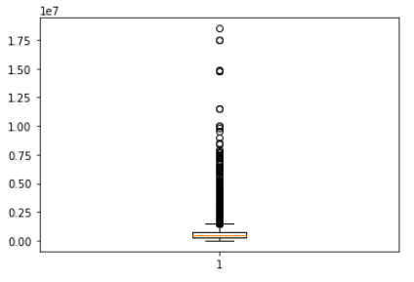
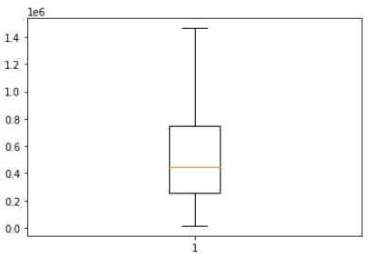
PREPROCESSING
Handling Outliers
Before Handling Outliers After Handling Outliers

Slide 14
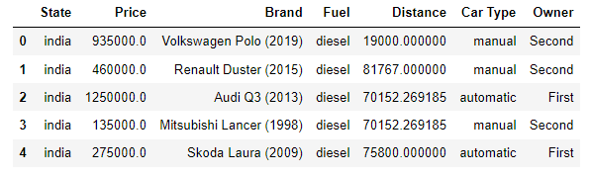
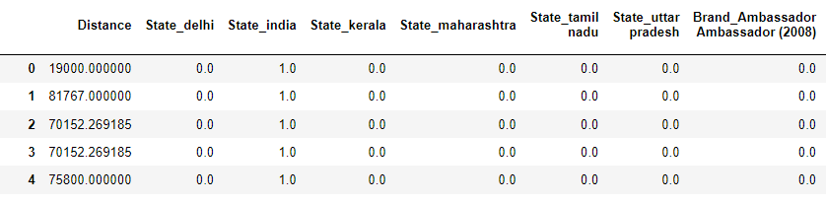
HANDLING CATEGORICAL DATA
We used One Hot Encoding() for handling categorical data
Categorical Data After Handling

Slide 15
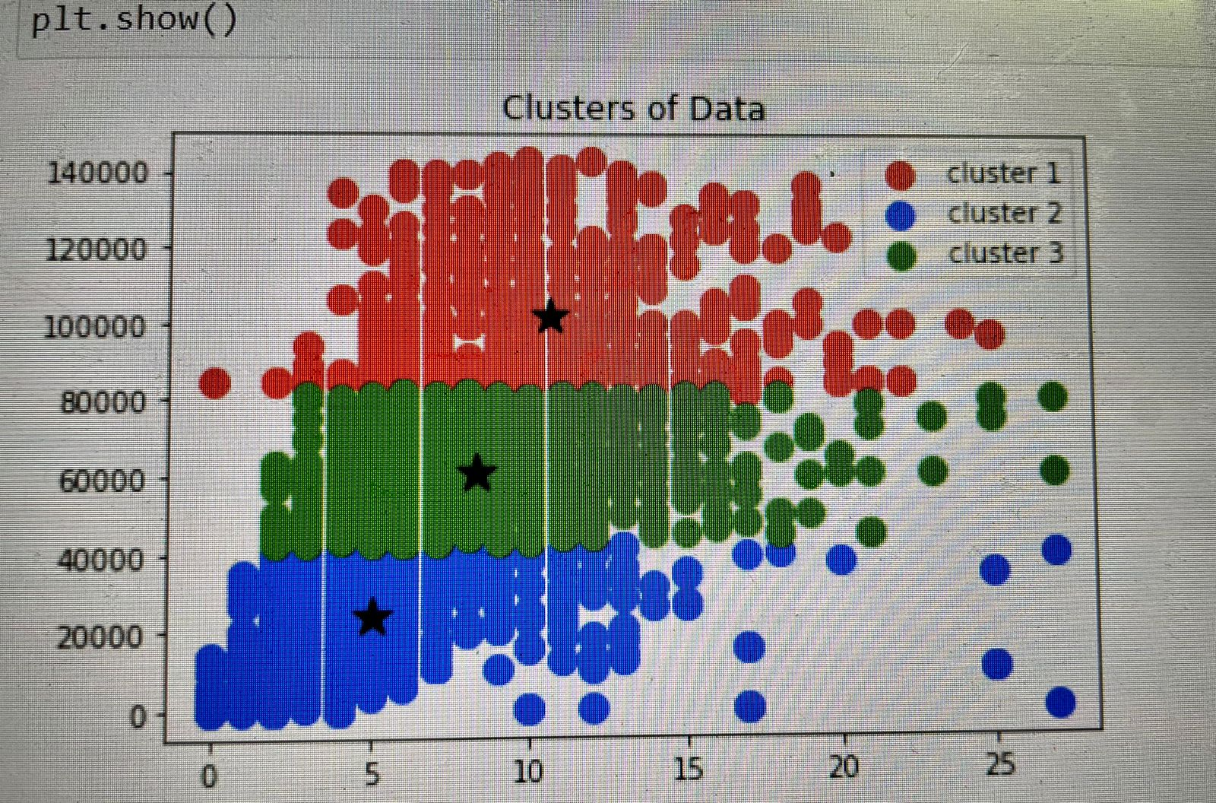
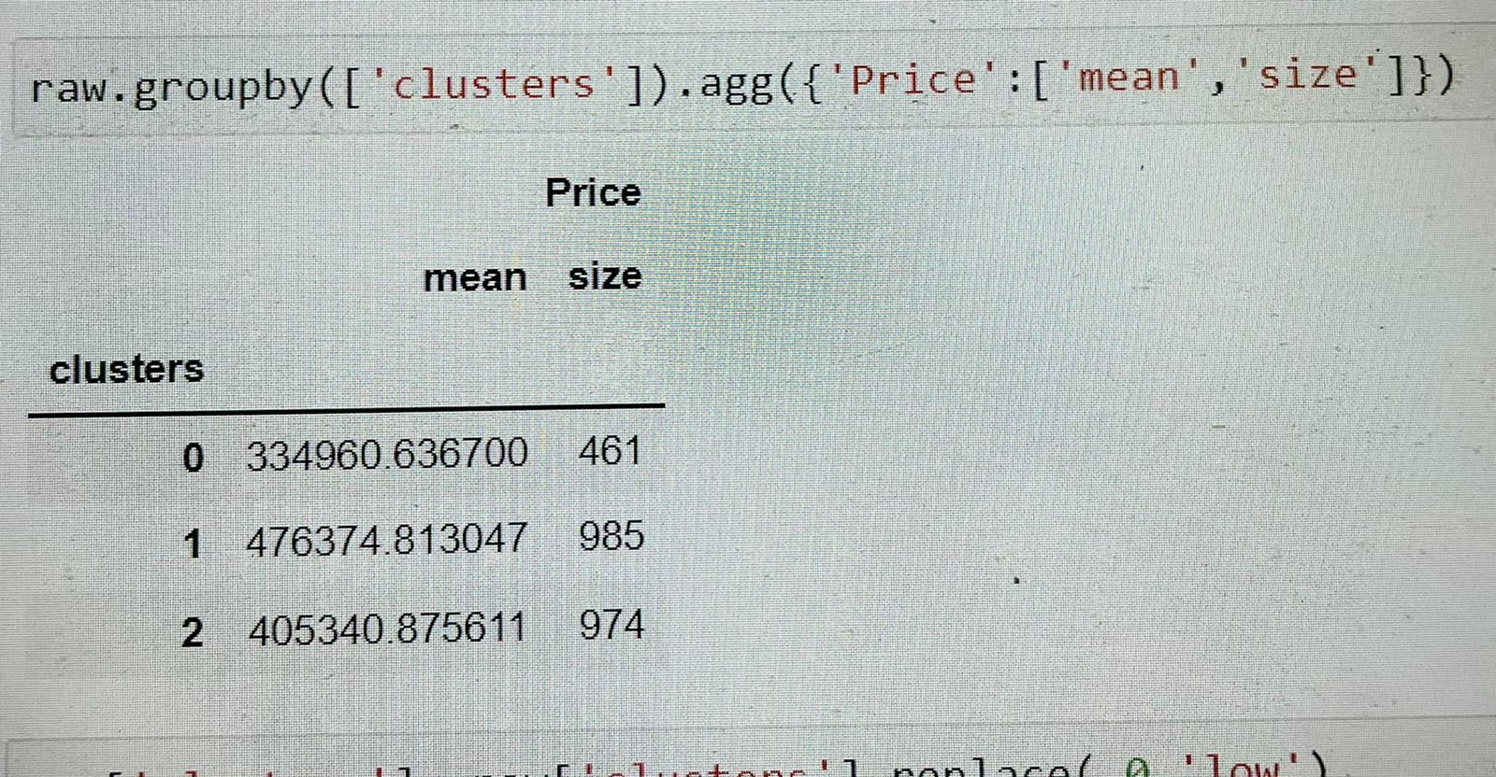
CLUSTERING
Clustering is the task of dividing the population or data points into a number of groups such that data points in the same groups are more similar to other data points in the same group than those in other groups.
Here we are using K-Means clustering
After applying K-Means we have got the below clusters

Slide 16
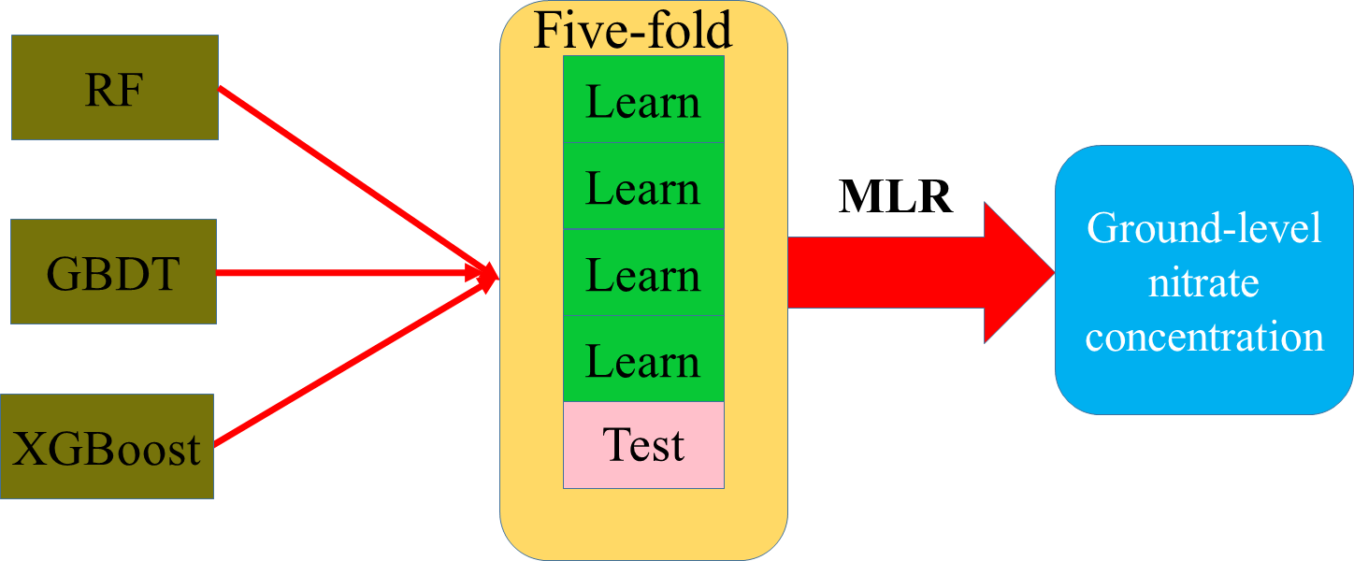
MODEL BULDING
Here we are using Ensemble model.
Random Forest Classification model. we have got an accuracy of 97%.

Slide 17
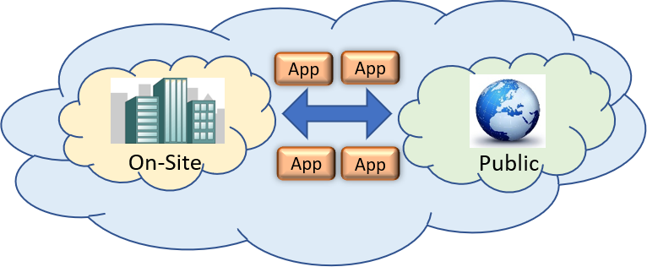
DEPLOYEMENT
Deployment is the method by which you integrate a machine learning model into an existing production environment to make practical business decisions based on data
In this project we have deployed our model into Local and Cloud server.
Local Server : Streamlit
Cloud Server : Heroku Server
My final cloud server url to access across the globe : https://quikr-carprices-ml.herokuapp.com/

Slide 18


